Slide 1

Module 2 – GeoBIM and Planning/Building Permits –
Lars Harrie
Lund University, Sweden
Claire Ellul
University College London, UK
Notes:
SLIDE 10 AND SLIDE 15 – PUT ARCSENE MAPS!!!!

Slide 2
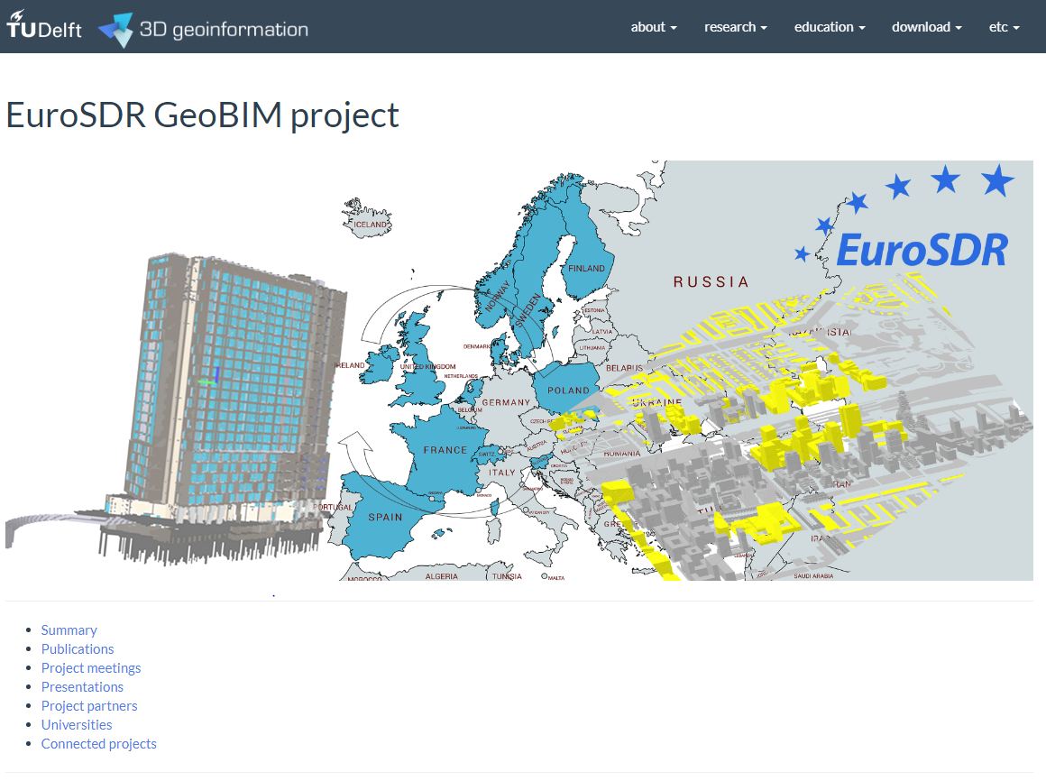
Main sources
Noardo, F., Ellul, C., Harrie, L., Olsson, P., Arroyo Ohori, K., Stoter, J. (2019). EuroSDR GeoBIM project: a study in Europe on how to use the potentials of BIM and geo data in practice. 3DGeoInfo2019 Conference, Singapore - International Archives of the Photogrammetry, Remote Sensing & Spatial Information Sciences IV-4(W8) 2019. https://doi.org/10.5194/isprs-archives-XLII-4-W15-53-2019
https://3d.bk.tudelft.nl/projects/eurosdr-geobim/

Slide 3
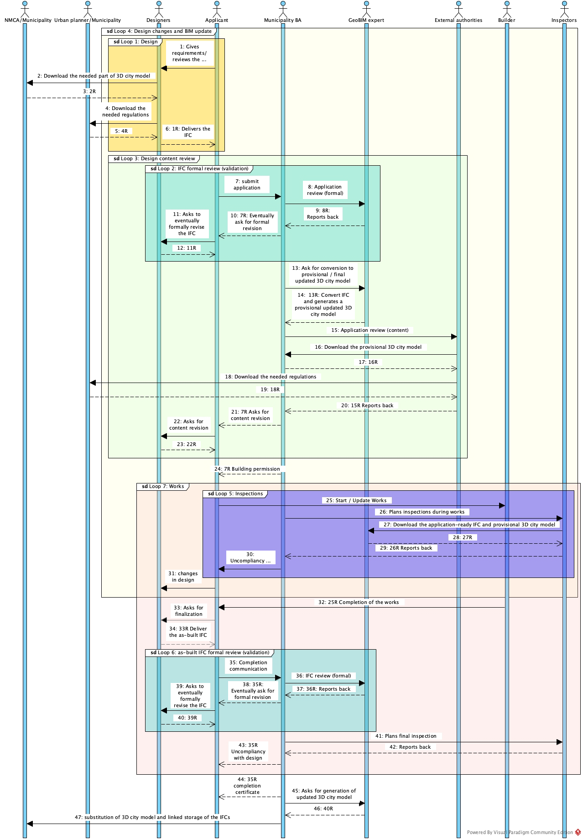
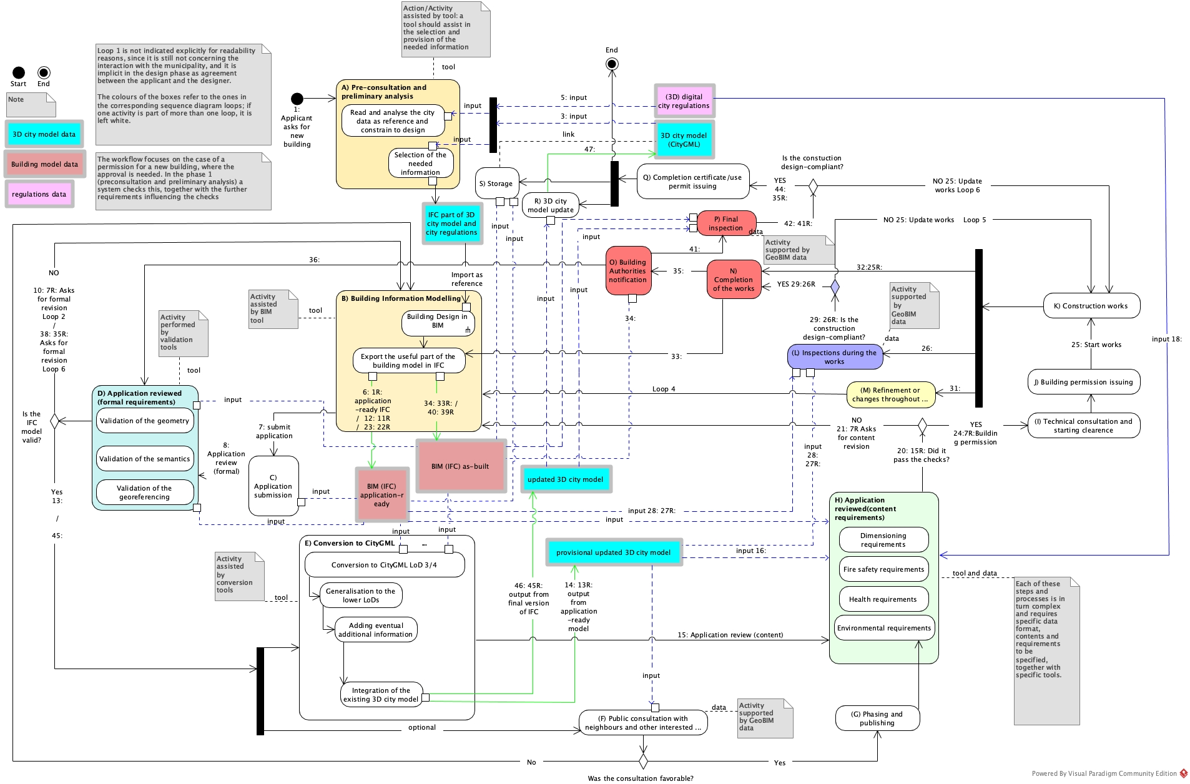
Workflow
Sequence
https://3d.bk.tudelft.nl/projects/eurosdr-geobim/
https://3d.bk.tudelft.nl/projects/eurosdr-geobim/WorkflowDescription.pdf

Slide 4
Other sources
Detailed delivery specifications for Geodata BIM
https://www.smartbuilt.se/projekt/informationsinfrastruktur/leveransspecifikationer/ (in Swedish)
OLSSON P.O., JOHANSSON T., ERIKSSON, H., LITHÉN T., BENGTSSON, L.-H., AXELSSON, J.ROOS, U., NELAND, K., RYDÉN, B., HARRIE, L., 2019.
Unbroken digital data flow in the built environment process - a case study in Sweden, Int. Arch. Photogramm.
Remote Sens. Spatial Inf. Sci., XLII-2/W13, 1347-1352, 2019
https://doi.org/10.5194/isprs-archives-XLII-2-W13-1347-2019. ISPRS Geospatial Week 2019, Enschede, June 10-14, 2019.
Several research projects – see references in the slides and the reading list
Some production systems and prototypes

Slide 5
Steps in the process
0) Site selection for investors – use GeoBIM to find out the potential of a site
1) Applicants asks for new building
2) Pre-consultation and preliminary analysis
3) Building information modelling
4) Application submission
5) Application reviewed (formal)
6) Conversion to CityGML
7) Application reviewed (content requirements)
8) Building permission issuing & start of construction works
9) Inspections during the works
10) Refinements or changes throughout construction process
11) Completion of the works & building authorities notification
12) As-built IFC formal review (validation)
13) Final inspection
14) Completion certificate / use permit issuing & 3D city model update & storage of BIMs
15) Handover to asset management

Slide 6
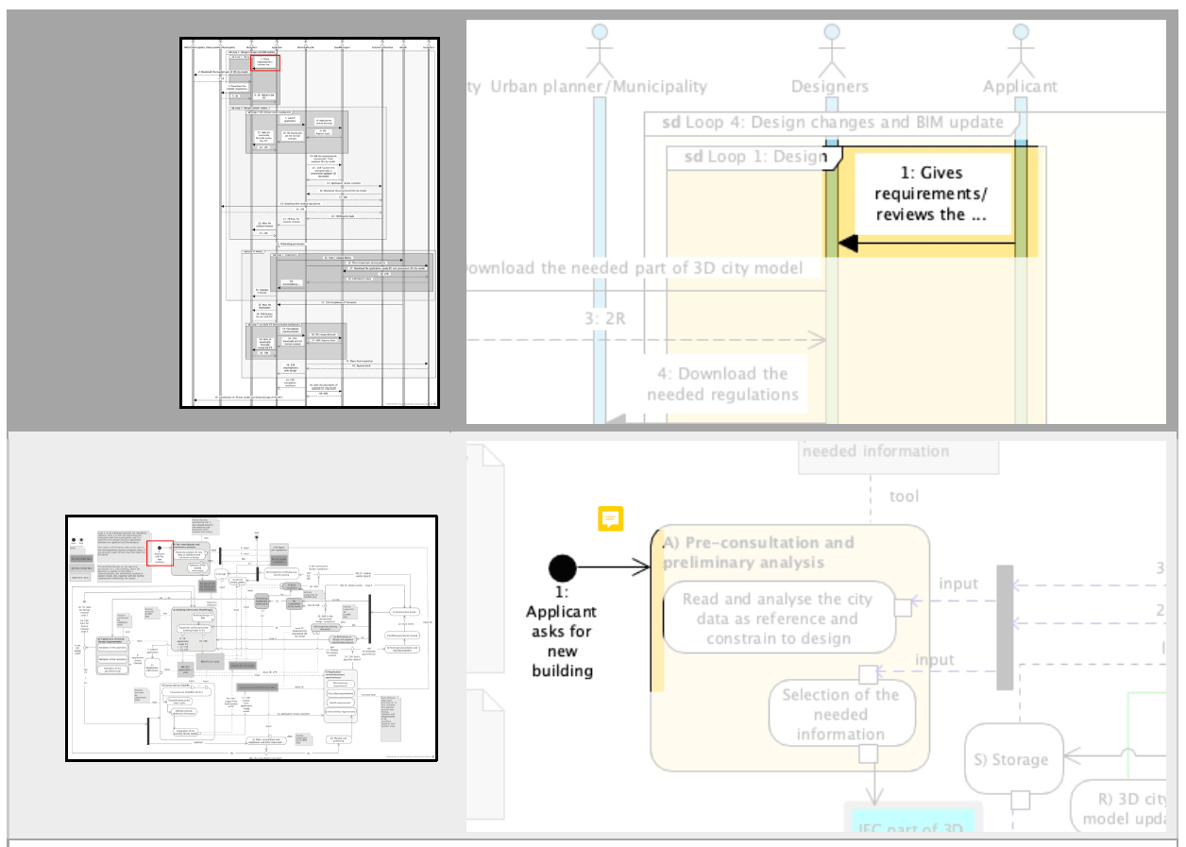
1) Applicants asks for new building
This presentation deals with the process of designing and constructing a new building.
The process is different for permissions for extensions/changes in buildings, etc.

Slide 7
Steps in the process
0) Site selection for investors – use GeoBIM to find out the potential of a site
1) Applicants asks for new building
2) Pre-consultation and preliminary analysis
3) Building information modelling
4) Application submission
5) Application reviewed (formal)
6) Conversion to CityGML
7) Application reviewed (content requirements)
8) Building permission issuing & start of construction works
9) Inspections during the works
10) Refinements or changes throughout construction process
11) Completion of the works & building authorities notification
12) As-built IFC formal review (validation)
13) Final inspection
14) Completion certificate / use permit issuing & 3D city model update & storage of BIMs
15) Handover to asset management

Slide 8
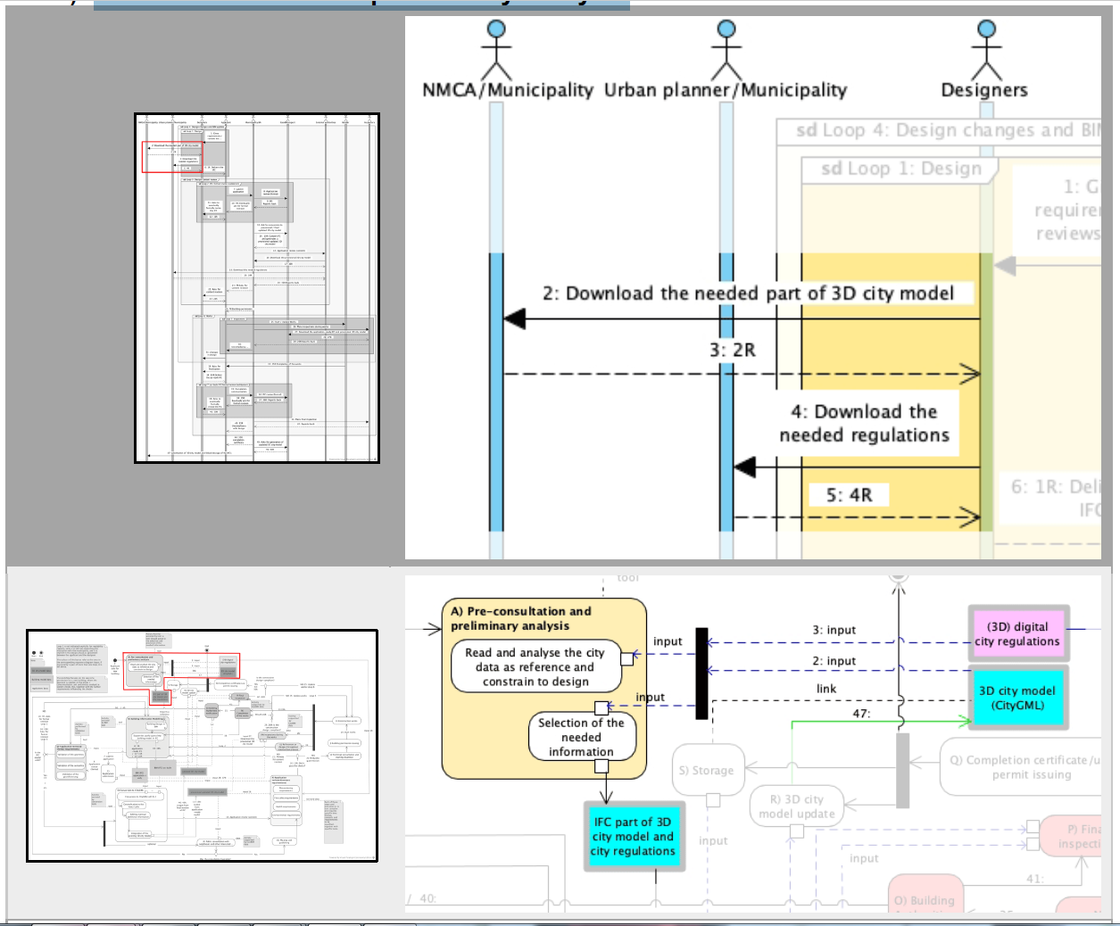
2) Pre-consultation and preliminary analysis

Slide 9
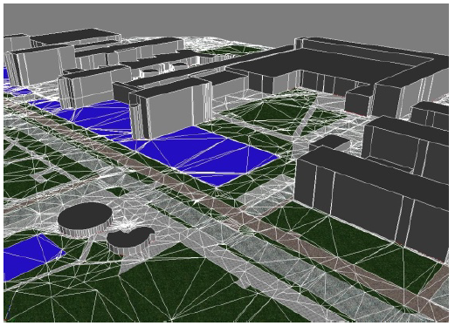
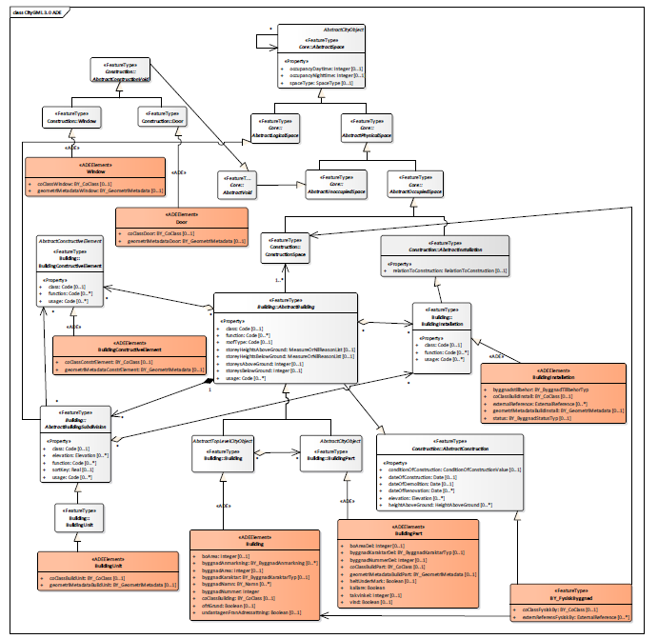
Requirement of national specifications for 3D city models
The Netherlands
3D IMGeo-CityGML
Sweden
CityGML Sve-Test
Source: Blaauboer et al. (2014)
Source: Eriksson et al. (2020)

Slide 10
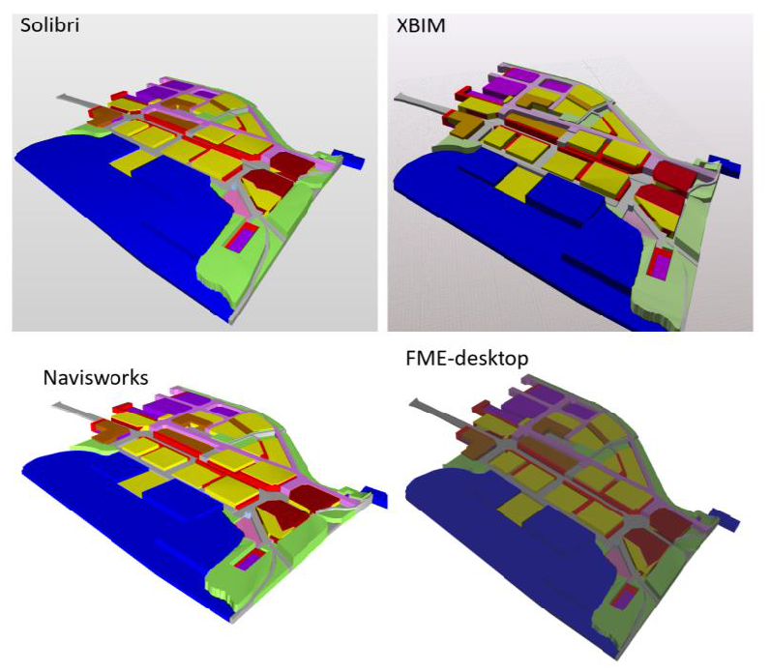
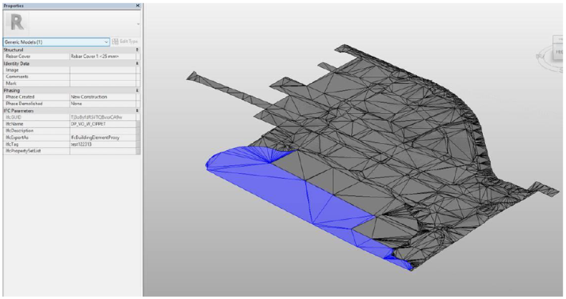
Limitations of importing geodata (City model data) to BIM tools
Generally, BIM tools cannot import
point and line object, and there are some
limitations on surface objects. BIM tools
are built for volumetric objects (as used in
the figures here).
Revit
Source: Detailed delivery specification for geodata-BIM

Slide 11
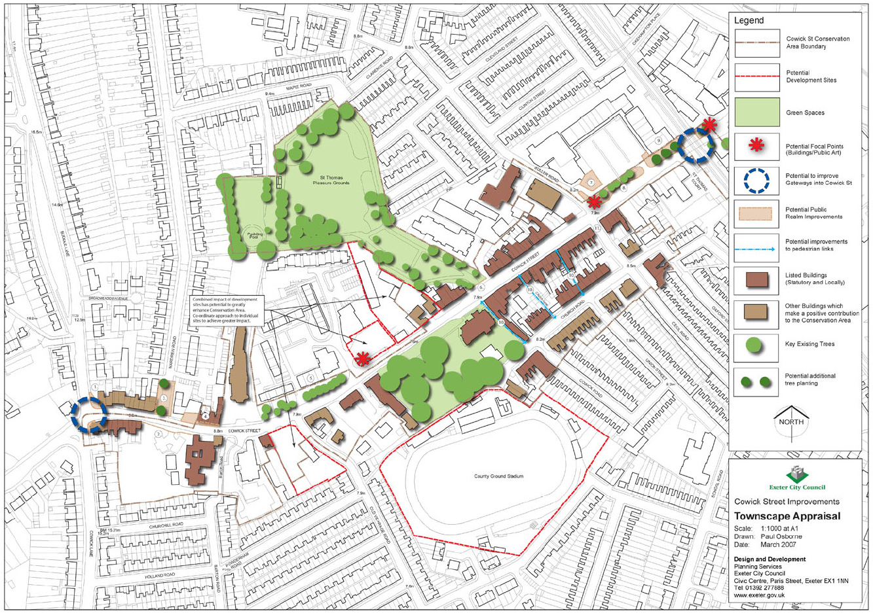
Regulations can be found in many planning instruments that varies between countries. Example UK: A landscape and townscape context plan
Source:
Exeter City Council

Slide 12
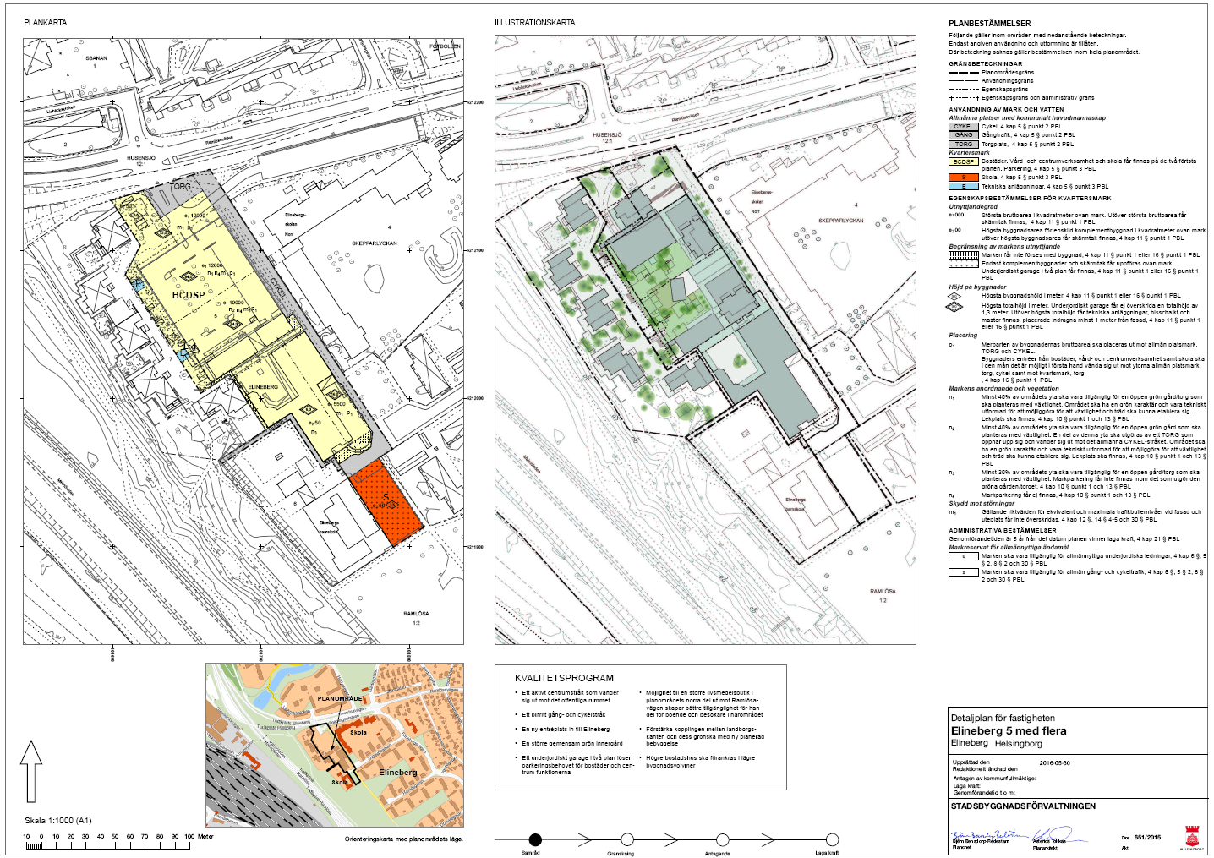
In this presentation we use: Detail development plans
Source: Helsingborg stad

Slide 13
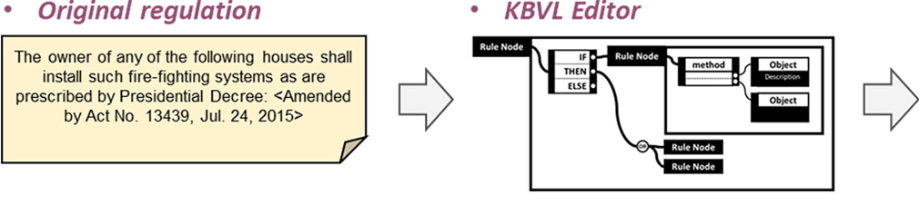
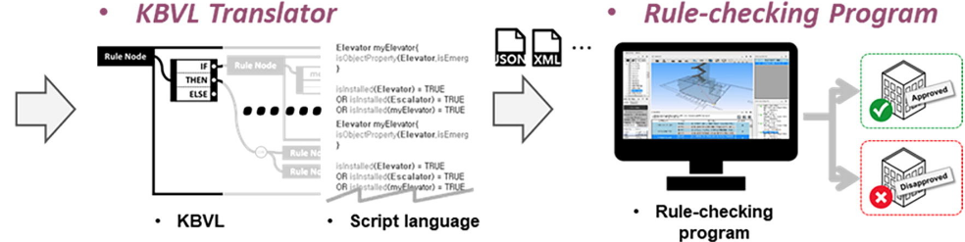
Digitalisation of detail development plans
An increasing number of countries require digital detail development plans.
Ongoing work to digitalise older paper plans.
Also digitalisation
of building rules
are required
Source: Kim et al. (2019): Visual language approach to representing
KBimCode-based Korea building code sentences for automated rule checking

Slide 14
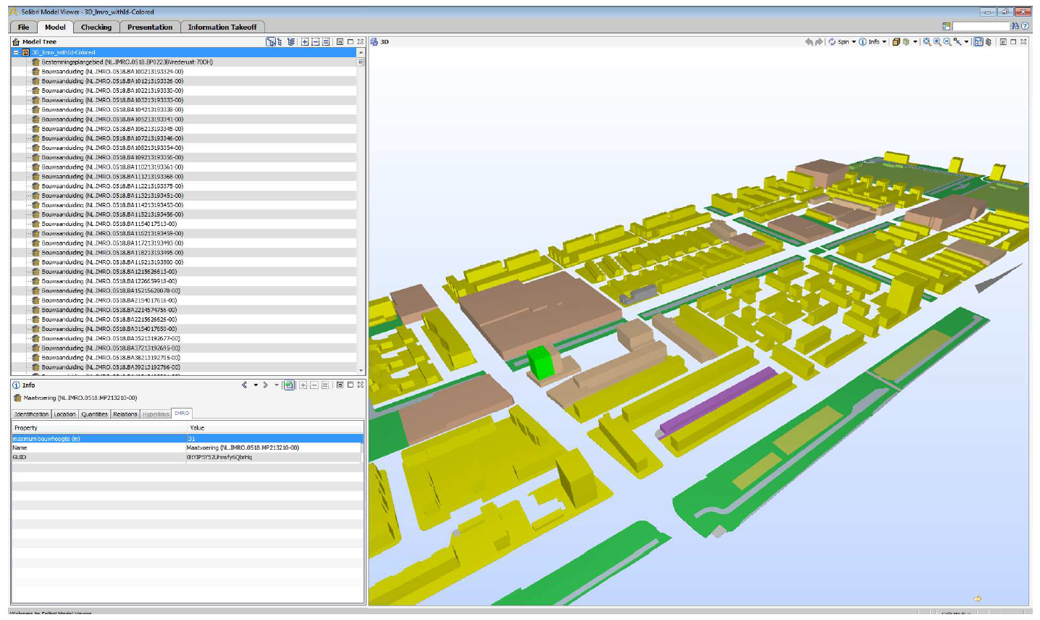
Import of digital detail development plan into BIM environment
Plan converted into
IFC and viewed in
Solibri Model Viewer
Source: van Berlo et al. (2013)

Slide 15
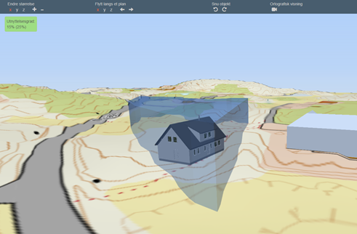
Applicant analysis before application
Service in Norway
https://bygglett.catenda.com/nysak

Slide 16
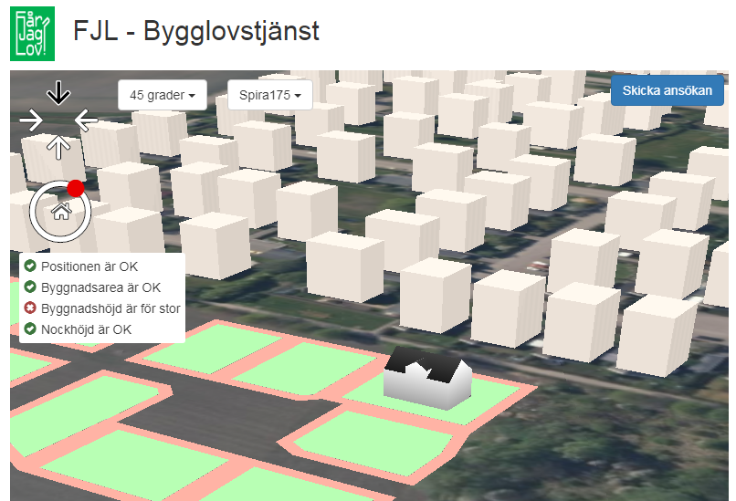
Applicant analysis before application
Prototype service created by Roger Groth, LU
http://fjl.gis.lu.se/

Slide 17
Steps in the process
0) Site selection for investors – use GeoBIM to find out the potential of a site
1) Applicants asks for new building
2) Pre-consultation and preliminary analysis
3) Building information modelling
4) Application submission
5) Application reviewed (formal)
6) Conversion to CityGML
7) Application reviewed (content requirements)
8) Building permission issuing & start of construction works
9) Inspections during the works
10) Refinements or changes throughout construction process
11) Completion of the works & building authorities notification
12) As-built IFC formal review (validation)
13) Final inspection
14) Completion certificate / use permit issuing & 3D city model update & storage of BIMs
15) Handover to asset management

Slide 18
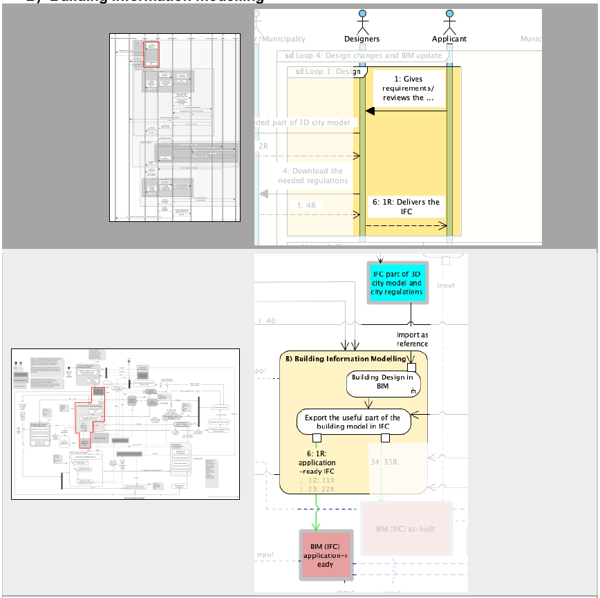
3) Building information modelling

Slide 19
Steps in the process
0) Site selection for investors – use GeoBIM to find out the potential of a site
1) Applicants asks for new building
2) Pre-consultation and preliminary analysis
3) Building information modelling
4) Application submission
5) Application reviewed (formal)
6) Conversion to CityGML
7) Application reviewed (content requirements)
8) Building permission issuing & start of construction works
9) Inspections during the works
10) Refinements or changes throughout construction process
11) Completion of the works & building authorities notification
12) As-built IFC formal review (validation)
13) Final inspection
14) Completion certificate / use permit issuing & 3D city model update & storage of BIMs
15) Handover to asset management

Slide 20
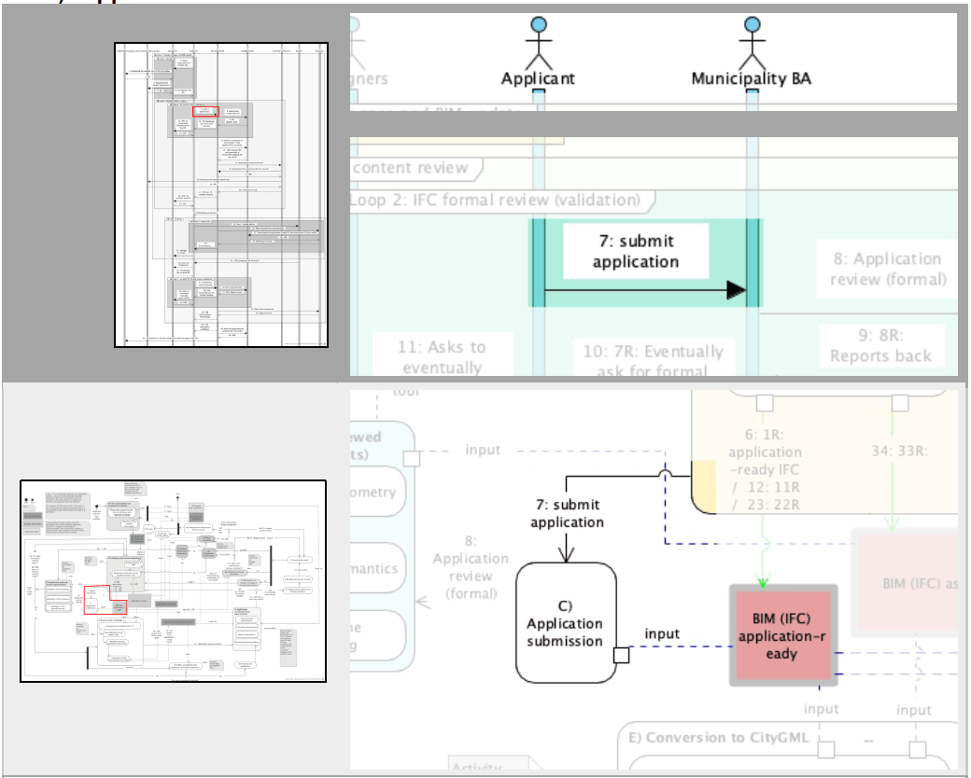
4) Application submission

Slide 21
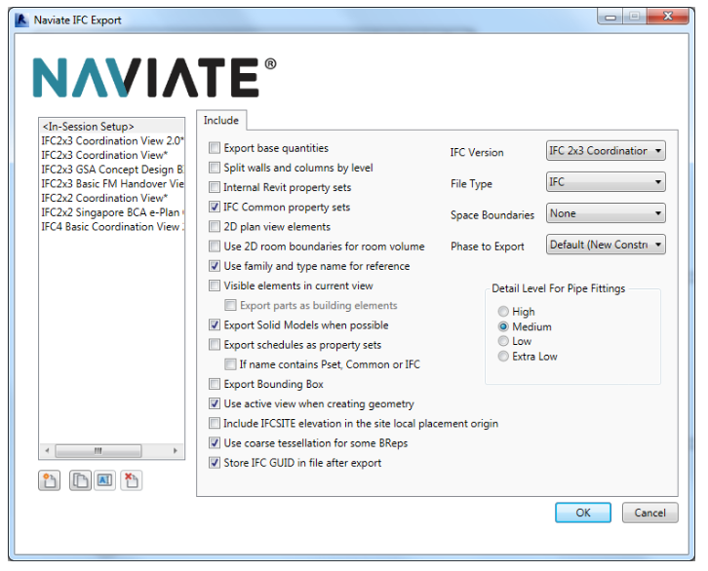
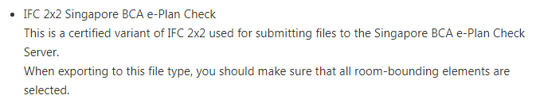
Model View Definition (MVD) – Formal subset of an IFC model. Example: Singapore

Slide 22
Steps in the process
0) Site selection for investors – use GeoBIM to find out the potential of a site
1) Applicants asks for new building
2) Pre-consultation and preliminary analysis
3) Building information modelling
4) Application submission
5) Application reviewed (formal)
6) Conversion to CityGML
7) Application reviewed (content requirements)
8) Building permission issuing & start of construction works
9) Inspections during the works
10) Refinements or changes throughout construction process
11) Completion of the works & building authorities notification
12) As-built IFC formal review (validation)
13) Final inspection
14) Completion certificate / use permit issuing & 3D city model update & storage of BIMs
15) Handover to asset management

Slide 23
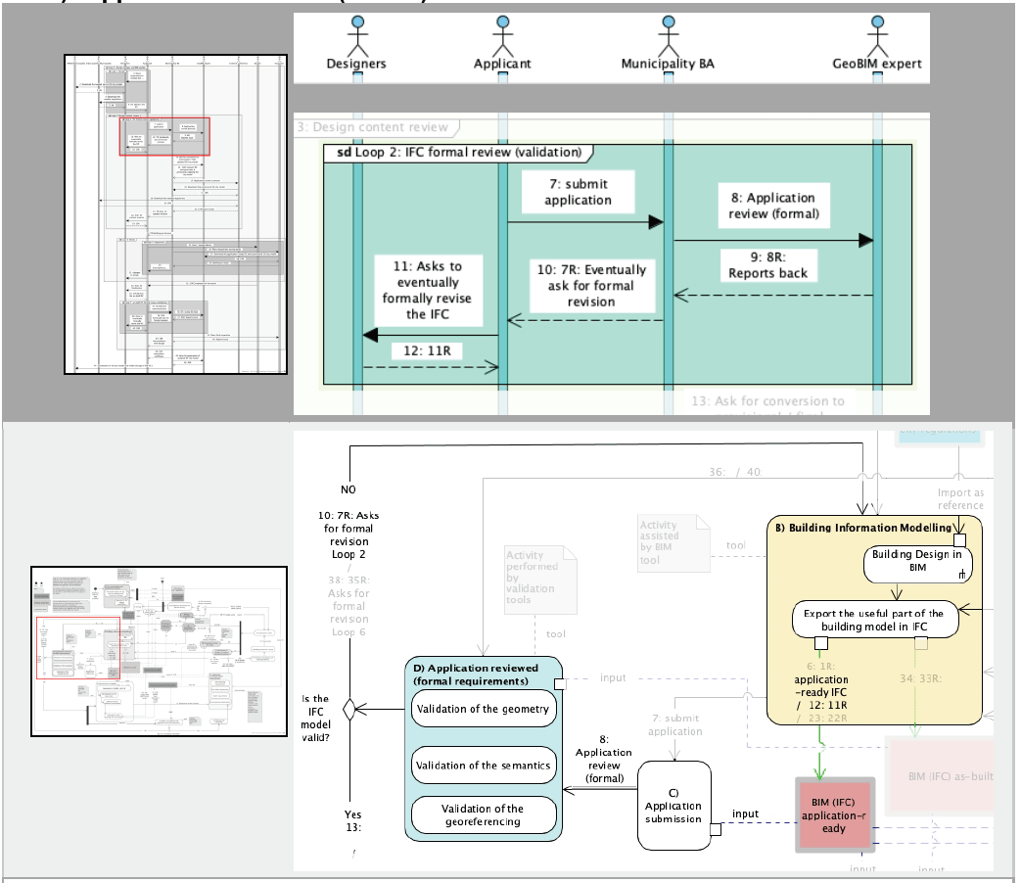
5) Application reviewed (formal)

Slide 24
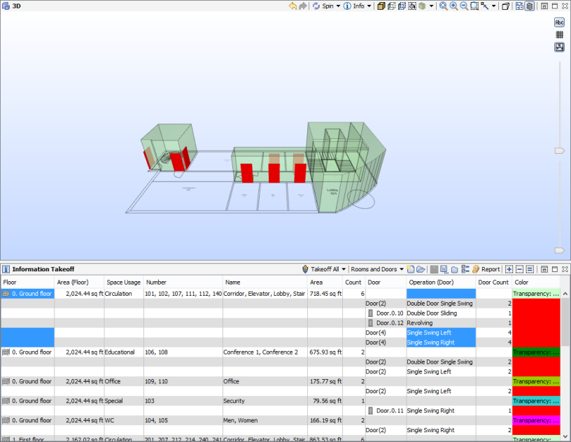
Formal checking of a BIM (IFC) file in BIM modeling checking tool
Source: Solibri.wordpress.com

Slide 25
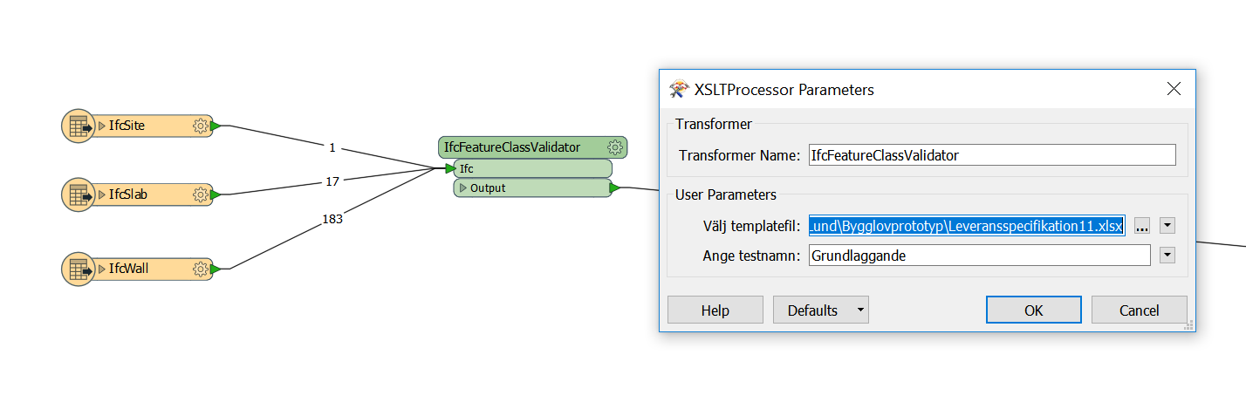
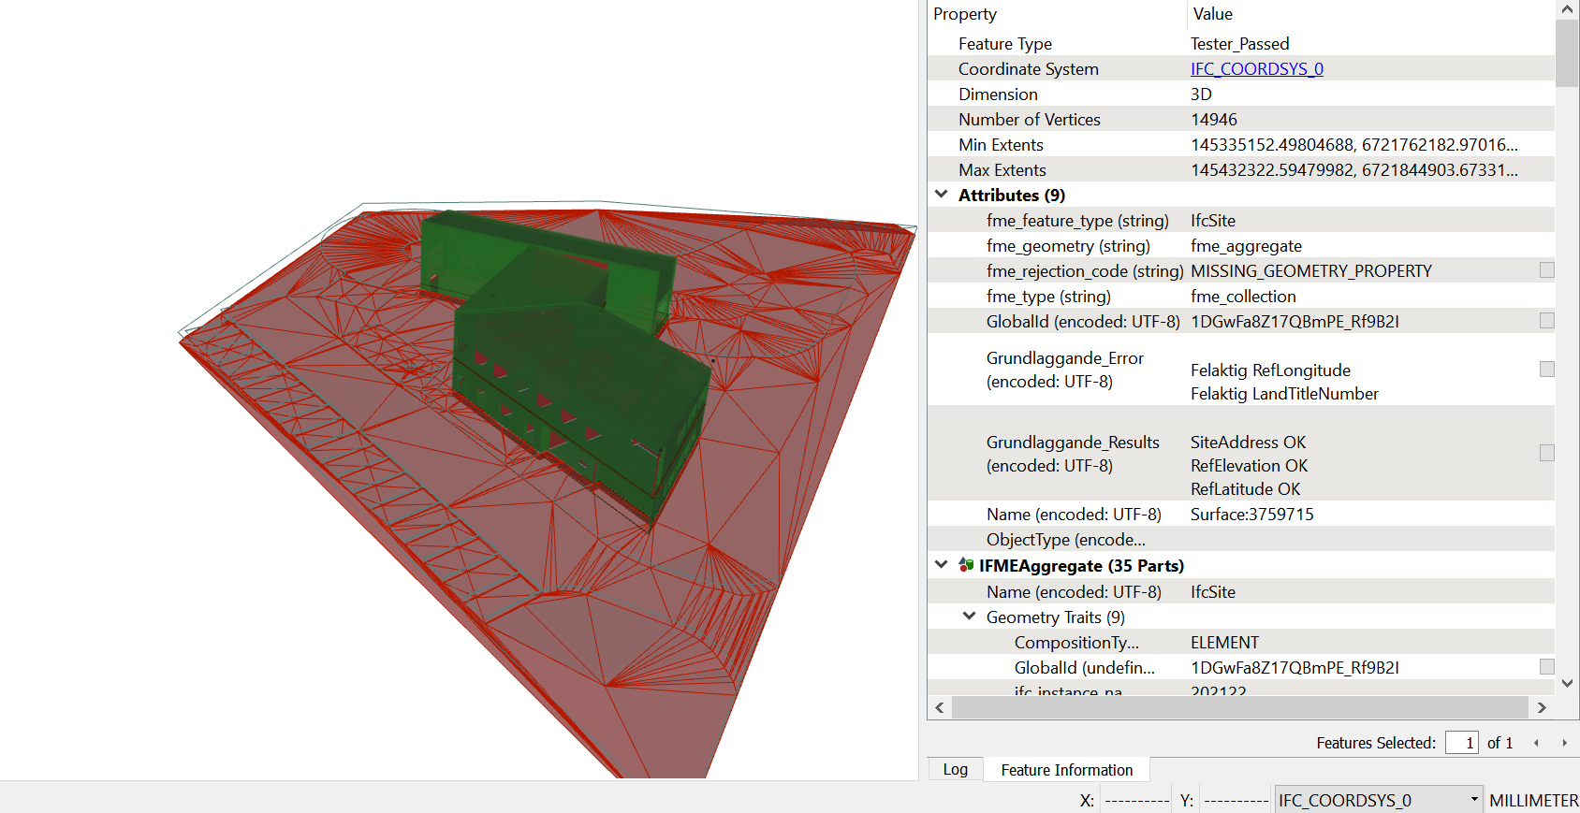
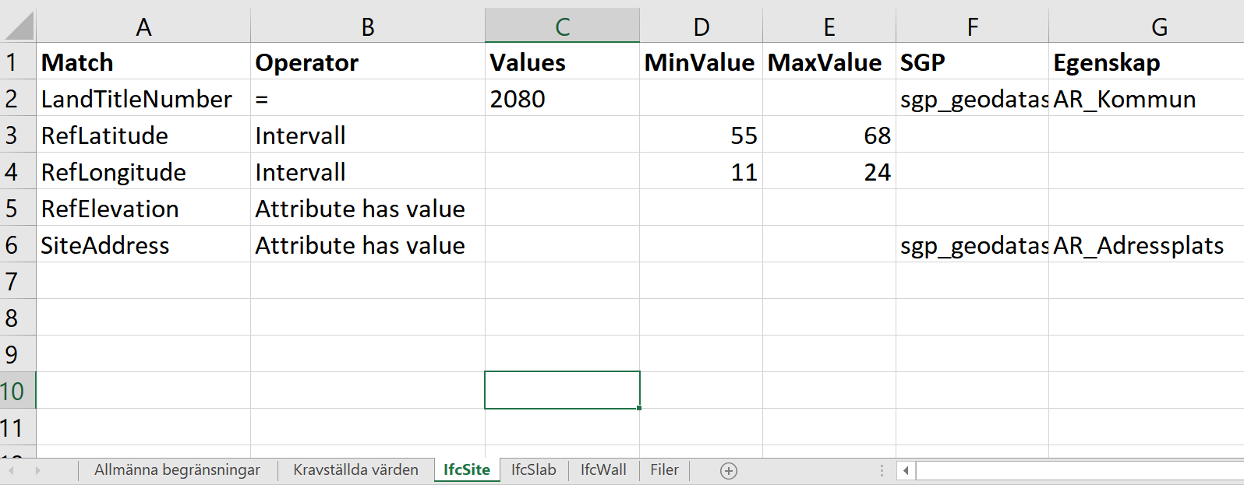
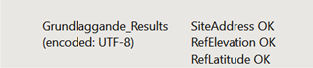
Checking elements according to MVD in an ETL-tool
IfcSite required
Custom transformer that reads
template file and check values.
Source: Detailed delivery specification for geodata-BIM

Slide 26
Steps in the process
0) Site selection for investors – use GeoBIM to find out the potential of a site
1) Applicants asks for new building
2) Pre-consultation and preliminary analysis
3) Building information modelling
4) Application submission
5) Application reviewed (formal)
6) Conversion to CityGML
7) Application reviewed (content requirements)
8) Building permission issuing & start of construction works
9) Inspections during the works
10) Refinements or changes throughout construction process
11) Completion of the works & building authorities notification
12) As-built IFC formal review (validation)
13) Final inspection
14) Completion certificate / use permit issuing & 3D city model update & storage of BIMs
15) Handover to asset management

Slide 27
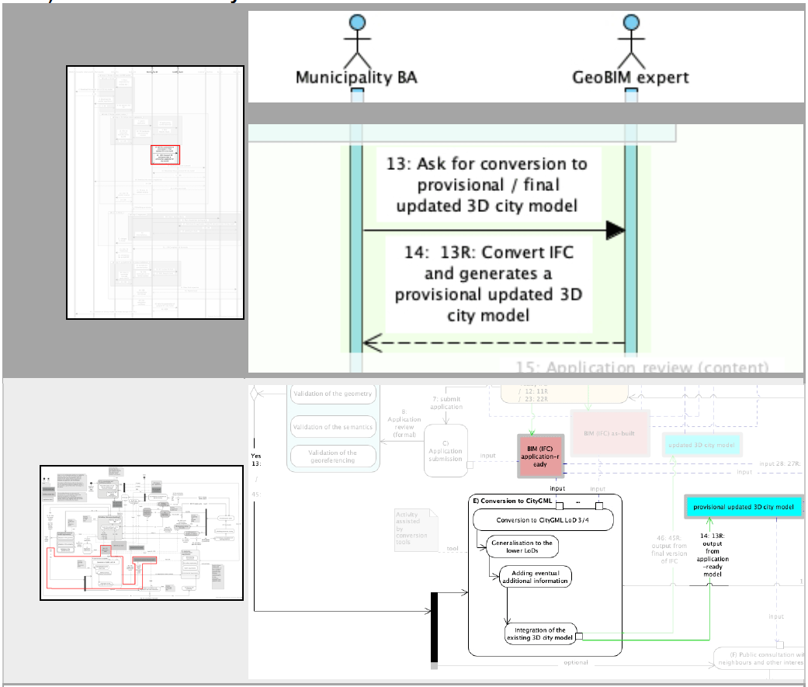
6) Conversion to CityGML

Slide 28
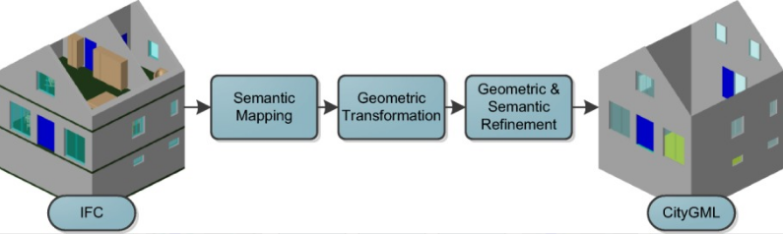
Example of workflow in the conversion
Source: Donkers et al. (2015)

Slide 29
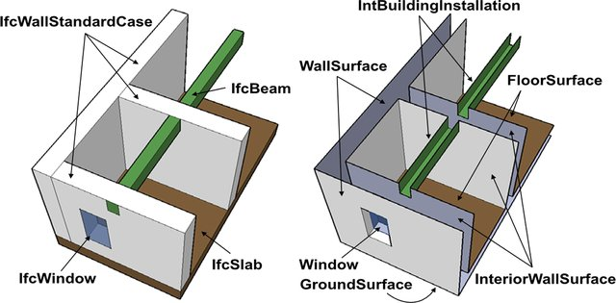
Geometric transformation
Challenges -
Different geometric
representations:
CityGML – B-rep
IFC – CSG, B-rep,
SweptSolid, etc.
Source: Nagel et al. (2009)
Sjors Donkers TU Delft MSc Dissertation:

Slide 30
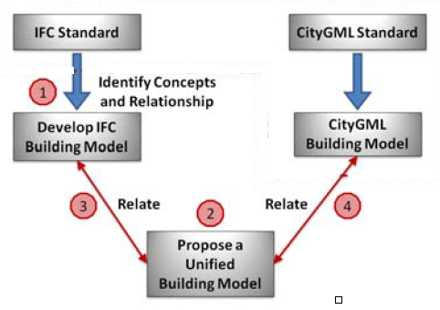
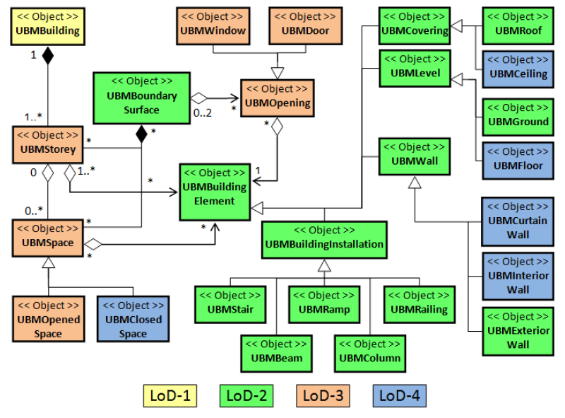
Semantic mapping
El-Mekawy et al. (2011)
Sjors Donkers TU Delft MSc Dissertation:

Slide 31
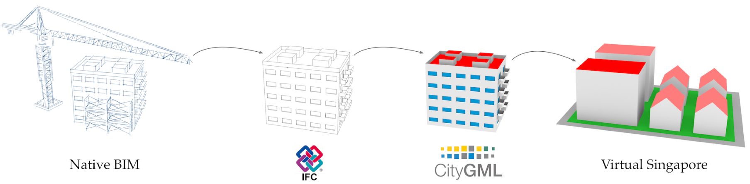
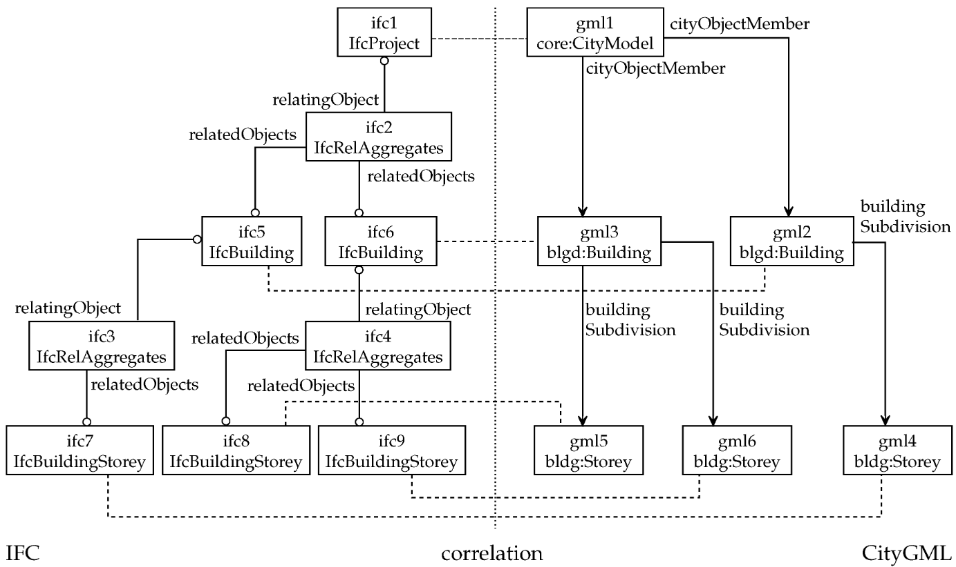
Example of study of conversion
A triple
graph approach
Source: Stouffs et al. (2018)

Slide 32
More on implementation of conversion tools will follow in module 4 (in the GeoBIM benchmark)

Slide 33
Steps in the process
0) Site selection for investors – use GeoBIM to find out the potential of a site
1) Applicants asks for new building
2) Pre-consultation and preliminary analysis
3) Building information modelling
4) Application submission
5) Application reviewed (formal)
6) Conversion to CityGML
7) Application reviewed (content requirements)
8) Building permission issuing & start of construction works
9) Inspections during the works
10) Refinements or changes throughout construction process
11) Completion of the works & building authorities notification
12) As-built IFC formal review (validation)
13) Final inspection
14) Completion certificate / use permit issuing & 3D city model update & storage of BIMs
15) Handover to asset management

Slide 34
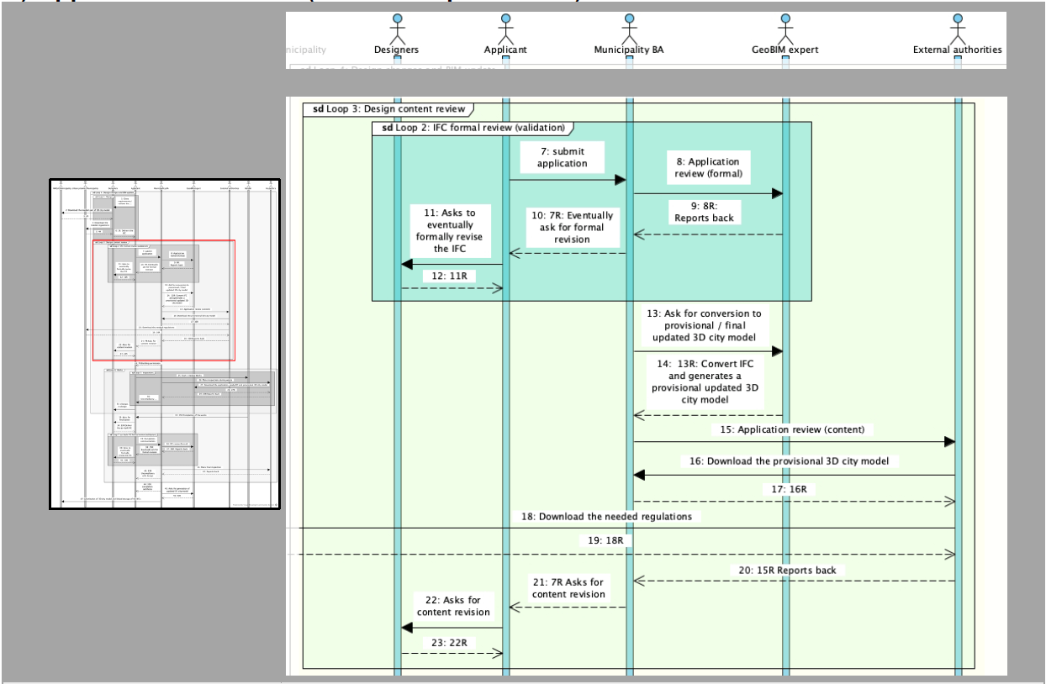
7) Application reviewed (content requirements)

Slide 35
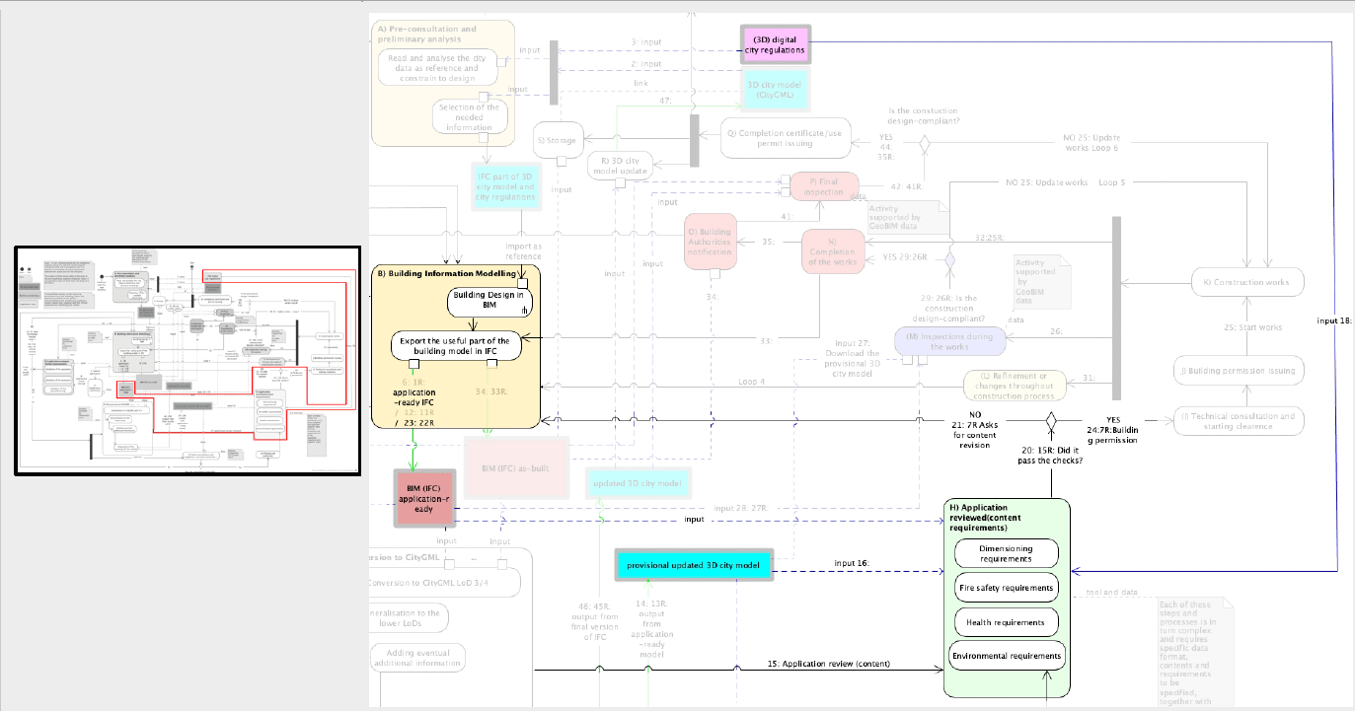
7) Application reviewed (content requirements)

Slide 36
What is required for building permit rule checking?
 | BIM data | Geospatial data | BIM & Geospatial data | Total
Quantitative | 25% | 30% | 30% | 85%
Visual | 2% | 1% | 2% | 5%
Qualitative | - | - | - | 10%
Study of the Swedish regulations defined by the National Board of Housing and Planning
Quantitative – BIM data |  | Roof pitch (degree)
Quantitative – Geospatial data | Slope of the ground (gradient)
Quantitative – BIM and geospatial data | Building heights (m) and densification levels (total building footprint area divided by real estate area)
Visual BIM data | Configuration of windows should follow certain characteristics
Visual Geospatial data | Configuration of property units
Visual BIM and geospatial data | General maintenance of the character in a built-up area
Qualitative | Maintenance of specific historical and artistic values
Example for each category
Source: Olsson et al. (2018)

Slide 37
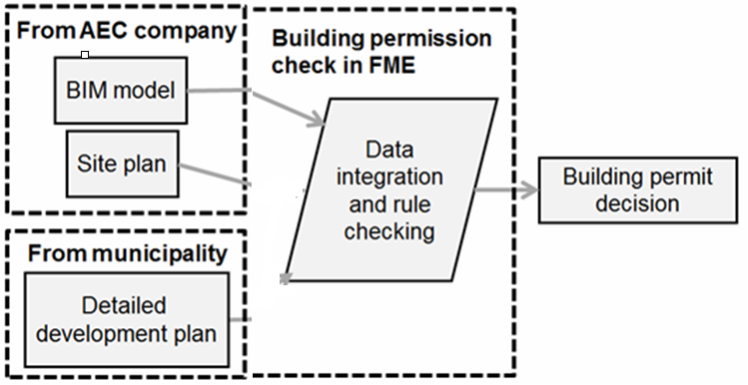
(Semi-) Automated building permit rule checking
Source: Detailed delivery specification for geodata-BIM

Slide 38
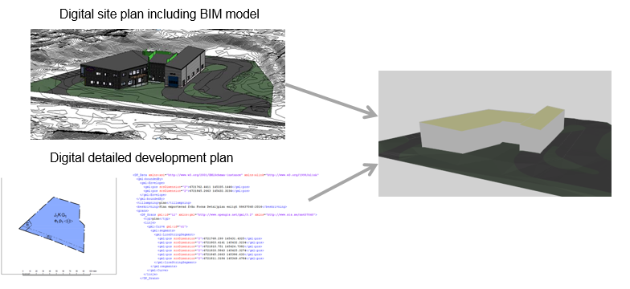
(Semi-) Automated building permit rule checking
Source: Detailed delivery specification for geodata-BIM

Slide 39
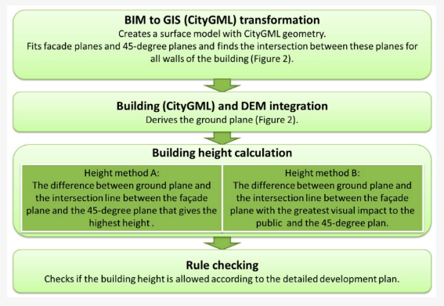
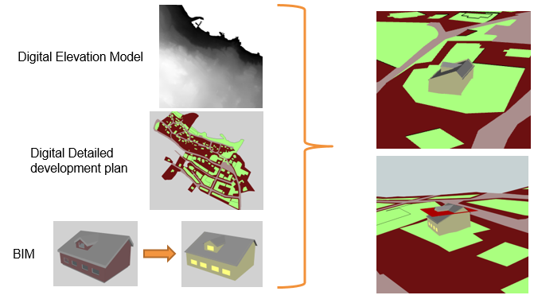
Controlling building heights
Source: Olsson et al. (2018)

Slide 40
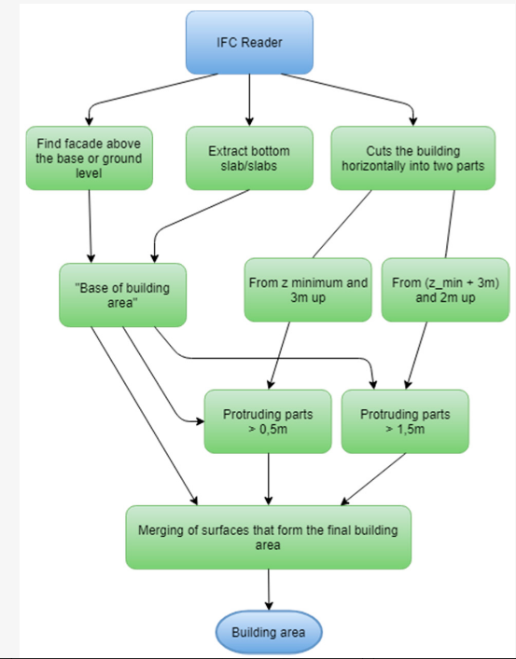
Architecture of an ETL-script developed to calculate building area
Source: Olsson et al. (2018)

Slide 41
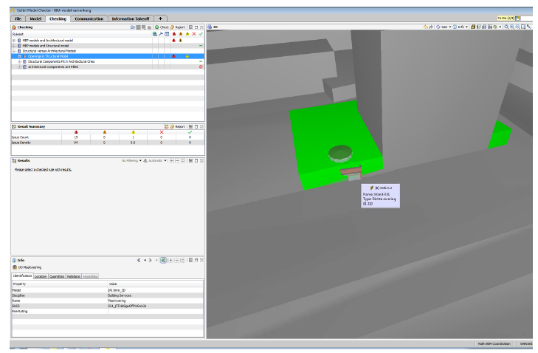
Checking regulations in BIM tools (Solibri)
Source: van Berlo et al. (2013)

Slide 42
Steps in the process
0) Site selection for investors – use GeoBIM to find out the potential of a site
1) Applicants asks for new building
2) Pre-consultation and preliminary analysis
3) Building information modelling
4) Application submission
5) Application reviewed (formal)
6) Conversion to CityGML
7) Application reviewed (content requirements)
8) Building permission issuing & start of construction works
9) Inspections during the works
10) Refinements or changes throughout construction process
11) Completion of the works & building authorities notification
12) As-built IFC formal review (validation)
13) Final inspection
14) Completion certificate / use permit issuing & 3D city model update & storage of BIMs
15) Handover to asset management

Slide 43
Steps in the process
0) Site selection for investors – use GeoBIM to find out the potential of a site
1) Applicants asks for new building
2) Pre-consultation and preliminary analysis
3) Building information modelling
4) Application submission
5) Application reviewed (formal)
6) Conversion to CityGML
7) Application reviewed (content requirements)
8) Building permission issuing & start of construction works
9) Inspections during the works
10) Refinements or changes throughout construction process
11) Completion of the works & building authorities notification
12) As-built IFC formal review (validation)
13) Final inspection
14) Completion certificate / use permit issuing & 3D city model update & storage of BIMs
15) Handover to asset management

Slide 44
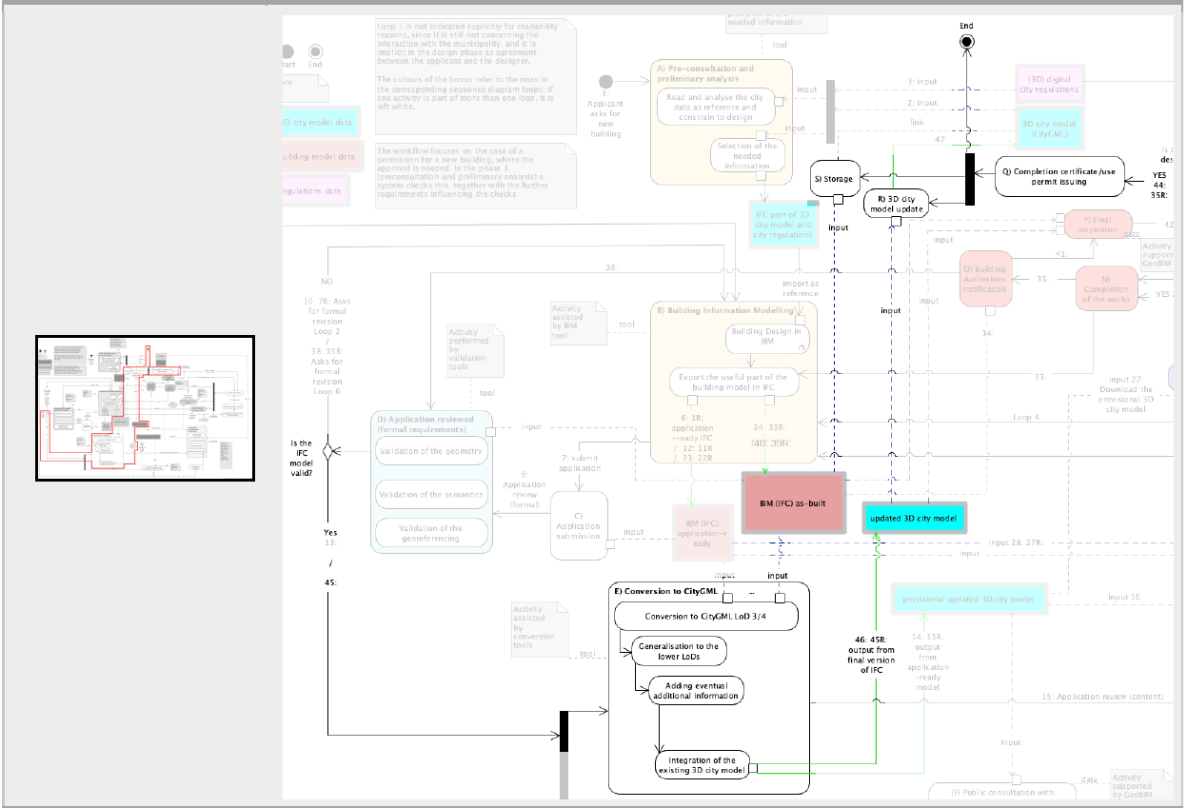
14) Completion certificate / use permit issuing & 3D city model update & storage of BIMs

Slide 45
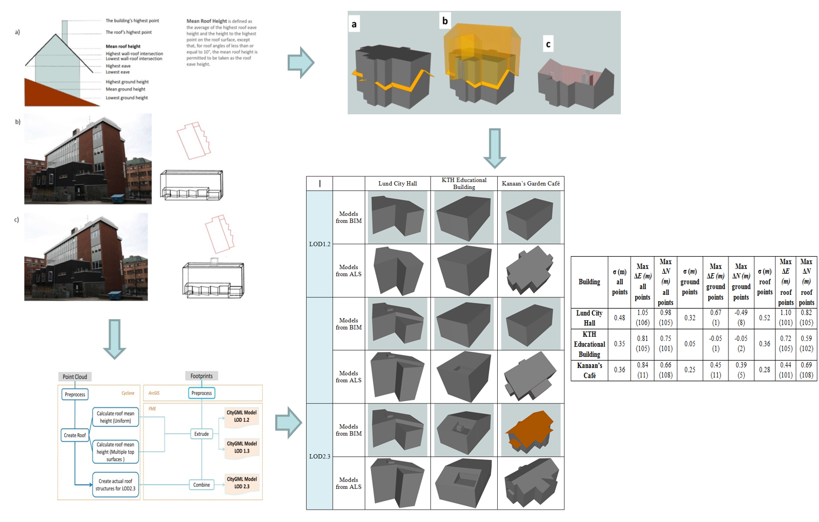
Geometric evaluation of CityGML model derived from BIM models
Source: Sun et al. (2019)

Slide 46
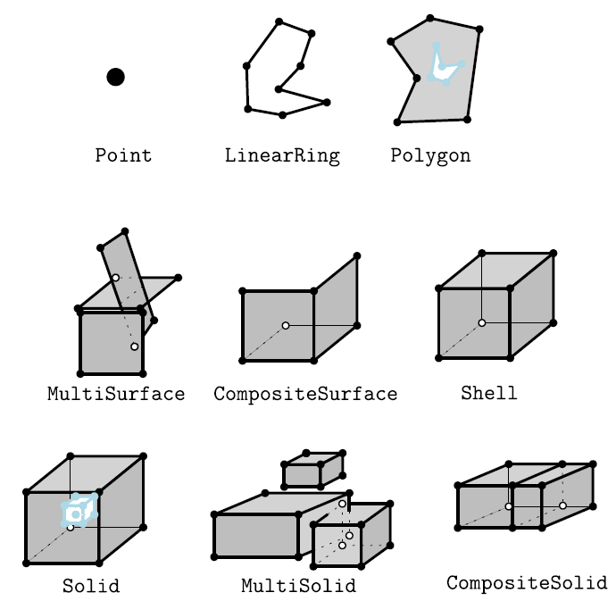
General validation of geometries
3D primitives validated
by val3dity
Source: Ledoux H. (2018). val3dity: validation of 3D GIS primitives according to the international standardsOpen Geospatial Data, Software and Standards (2018) 3:1
https://doi.org/10.1186/s40965-018-0043-x

Slide 47
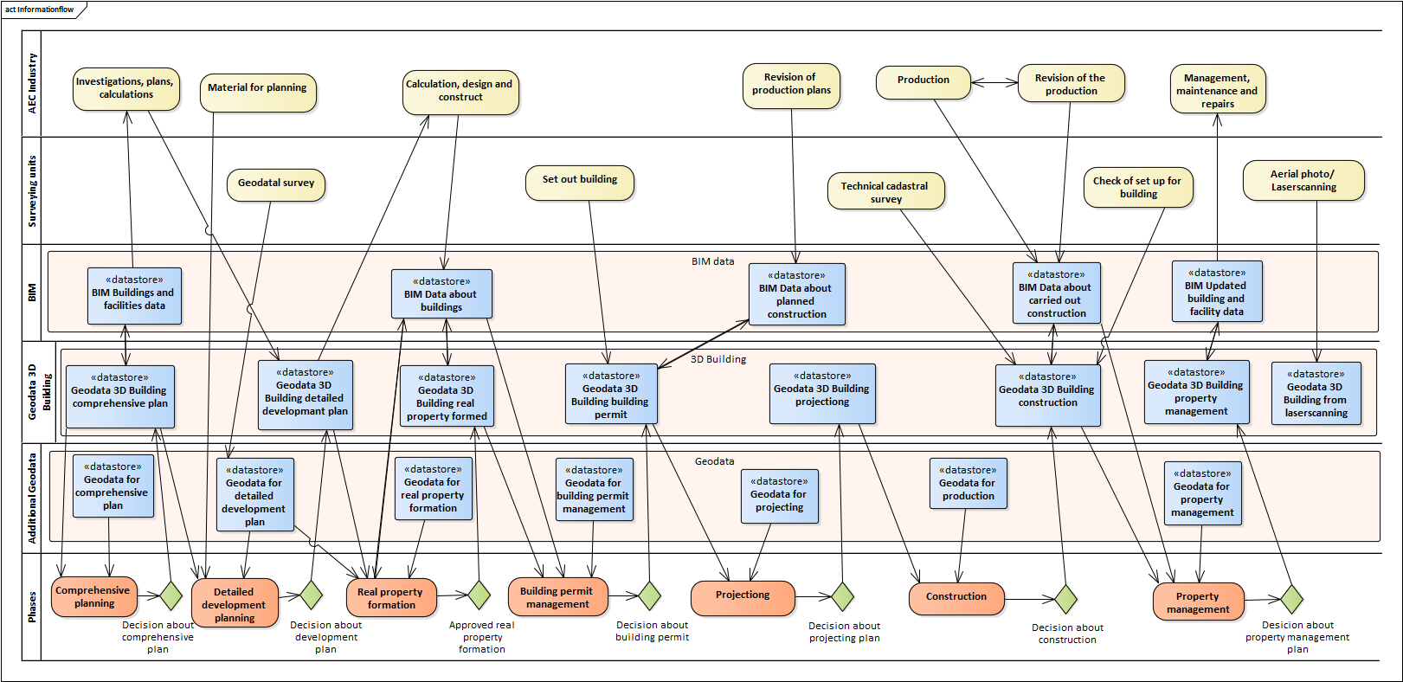
Version management in the update process
Source: Eriksson et al. (2020)

Slide 48
Steps in the process
0) Site selection for investors – use GeoBIM to find out the potential of a site
1) Applicants asks for new building
2) Pre-consultation and preliminary analysis
3) Building information modelling
4) Application submission
5) Application reviewed (formal)
6) Conversion to CityGML
7) Application reviewed (content requirements)
8) Building permission issuing & start of construction works
9) Inspections during the works
10) Refinements or changes throughout construction process
11) Completion of the works & building authorities notification
12) As-built IFC formal review (validation)
13) Final inspection
14) Completion certificate / use permit issuing & 3D city model update & storage of BIMs
15) Handover to asset management

